Slide 1

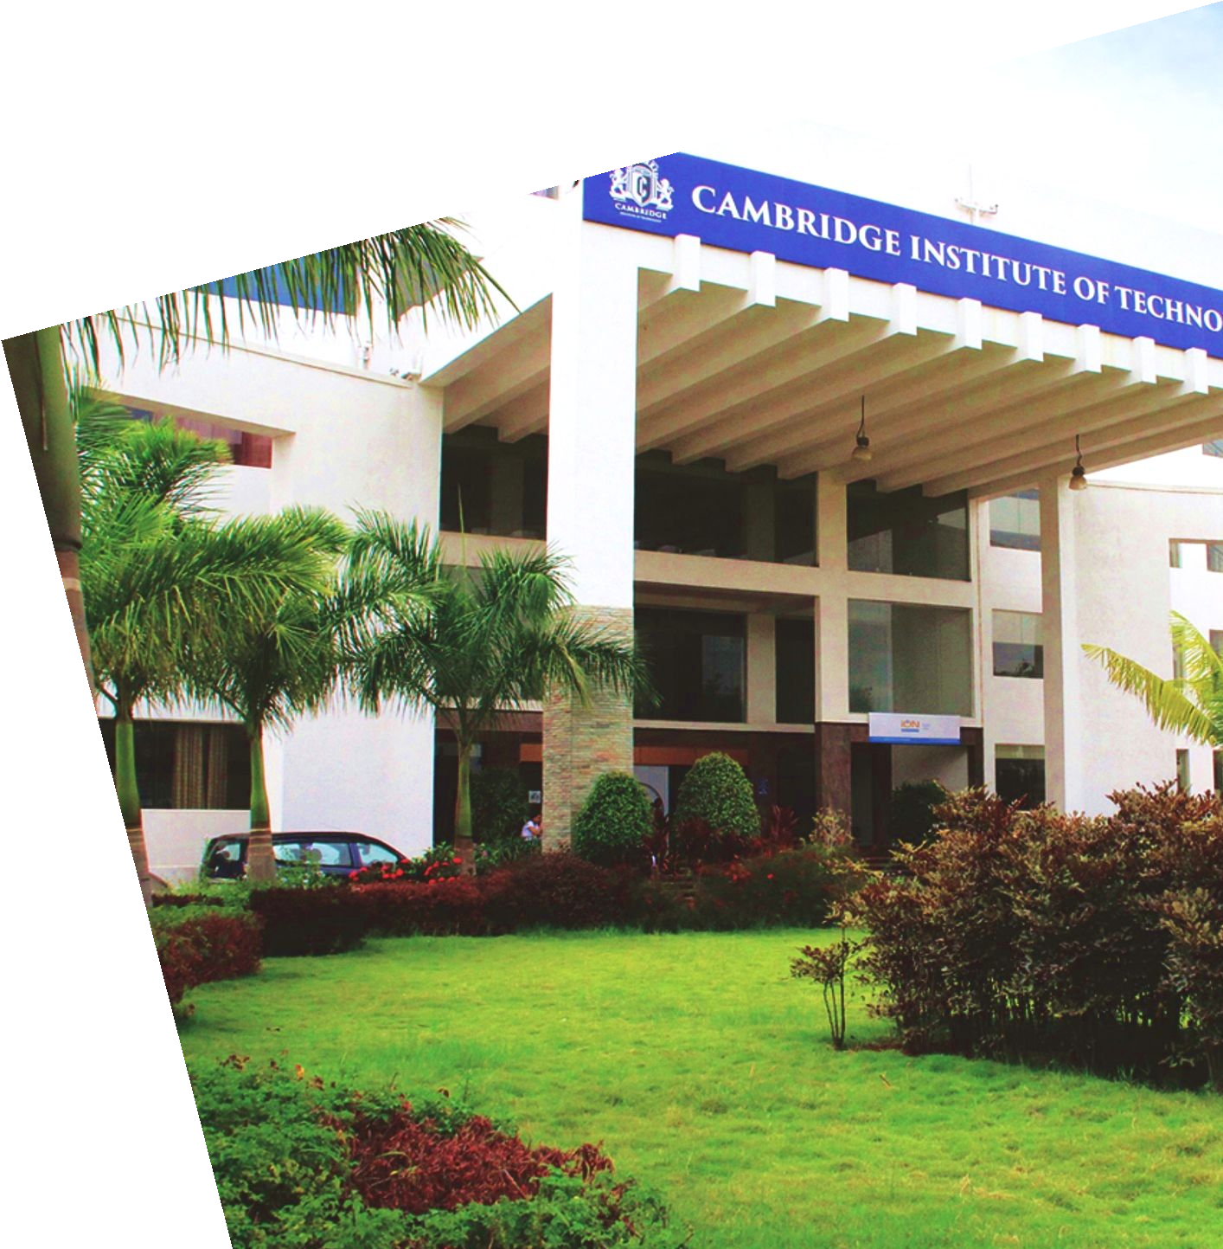
“MUSIC THEARPY USING FACIAL EXPRESSION USING MACHINE LEARNING”
Internship Project Presentation
On
By
Yashwini
1CD23SCS17
Under the Guidance of
Dr.Vasantha. M
Associate. Professor

Slide 2
Contents
Introduction
About the company
Company Products
Company services
Tools and techniques learned
Proposed System
Applications
Hardware and Software Requirements
Architecture
Methodology
Result
Conclusion

Slide 3

About the company
Knowx Innovations Pvt Ltd., was established in the year 2005 by a group of tech savvy professionals with a multifaceted hardware and software background focuses on engineering services and IT staffing solutions.
Specialization: Embedded Systems Design, Product Engineering, IoT, and AI
Technology Clients: Telecom, automotive, multimedia, defense, aerospace, and education sectors

Slide 4
Products
Home Automation Solutions
Control home appliances via smartphone applications using the latest IoT technology.
Remote Data Acquisition Systems
Integrated solutions for test, measurement, and data acquisition compatible with various devices and applications.
Advanced Product Offerings
Vehicle Movement and Control Systems
Advanced automotive technologies enhancing user experience and vehicle quality.
IoT-Based Data Logger
GPRS-enabled devices functioning as remote data loggers or components of Machine-to-Machine (M2M) solutions.

Slide 5
Services
Embedded System & Product Engineering: Expertise in hardware design, embedded software development, and product prototyping.
Internet of Things (IoT): Development of smart solutions with cloud integrations (AWS, Azure, Google Cloud).
Artificial Intelligence (AI): AI-driven solutions using Keras, TensorFlow, and machine learning frameworks.
Staffing Solutions: Contract, permanent staffing, and IT infrastructure management services.
Additional Services: Digital signal processing, VLSI, app development, and cloud computing.

Slide 6
Tools and Techniques Learned
Pandas
A powerful library for data manipulation and analysis.
Key Features:
DataFrame and Series data structures.
Reading/writing CSV, Excel, and other formats.
Data cleaning and aggregation.
Use Case: Cleaning and preprocessing datasets for AI models.

Slide 7
Tools and Techniques Learned
NumPy
A fundamental library for numerical computing in Python.
Key Features:
Multi-dimensional arrays (ndarray).
Mathematical functions for linear algebra and statistics.
Use Case: Handling complex mathematical computations in ML models

Slide 8
Tools and Techniques Learned
PyAudio
A Python library for working with audio streams.
Key Features:
Audio input/output handling.
Real-time audio processing.
Use Case: Speech recognition and audio classification.

Slide 9
Tools and Techniques Learned
SMTP
Simple Mail Transfer Protocol for sending emails.
Key Features:
Secure email communication.
Automation of notification systems.
Use Case: Sending model training status updates via email.

Slide 10
Tools and Techniques Learned
Scikit-Learn
A library for machine learning and data mining.
Key Features:
Supervised and unsupervised learning models.
Model evaluation and parameter tuning.
Use Case: Building and evaluating classification models.

Slide 11
Tools and Techniques Learned
TensorFlow
An open-source framework for building and training neural networks.
Key Features:
Tensor operations and automatic differentiation.
Support for deep learning models (CNN).
Use Case: Building image classification models.

Slide 12
Proposed system
The proposed system aims to automate the playlist generation process based on facial emotion recognition. By eliminating the manual task of song selection, the system provides a seamless and personalized music experience. With accuracy rates of 85-90% for real-time images and 98-100% for static images, it offers efficient, cost-effective, and high-performance emotion detection and music recommendation capabilities.

Slide 13
Applications
Entertainment Industry: Personalized music streaming based on user emotions.
Healthcare: Therapeutic music selection for mental well-being.
Smart Home Systems: AI-driven music controls for enhancing user experience.
Retail Spaces: Setting mood-based ambiance music for customers.

Slide 14
Hardware and Software Requirements
Software Requirements:
Python 3.x
OpenCV
Keras and TensorFlow
Windows Media Player (win32com client)
Haar Cascade XML files
Hardware Requirements:
PC or Laptop with Windows OS
In-built or external Webcam
Minimum 4GB RAM
Speakers for audio playback

Slide 15
Architecture
Face detection using web camera
Facial landmark extraction
Facial expression detection
Music player
Angry
happy
sad
neutral
surprise

Slide 16
Methodology(Cont..)
Face Detection:
Uses OpenCV's Haar Cascade for frontal face detection.
Captures frames from the webcam.
Emotion Recognition:
Pre-processes images and uses a trained Keras model.
Identifies emotions such as Angry, Happy, Neutral, Sad, and Surprise.

Slide 17
Methodology(Cont..)
Music Mapping:
Matches detected emotions to specific music tracks.
Uses Windows Media Player (via win32com) for playback.
User Interaction:
Displays detected emotion and starts the corresponding music.
Allows the user to stop playback manually.

Slide 18
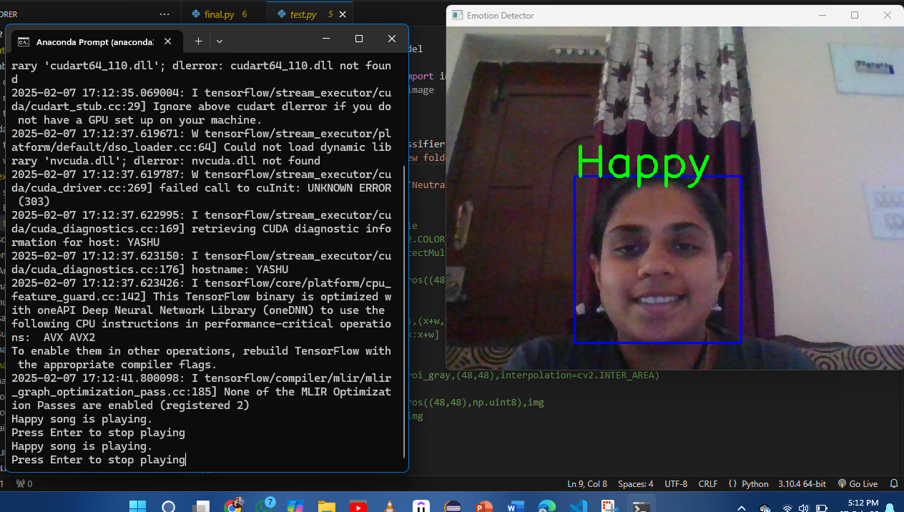
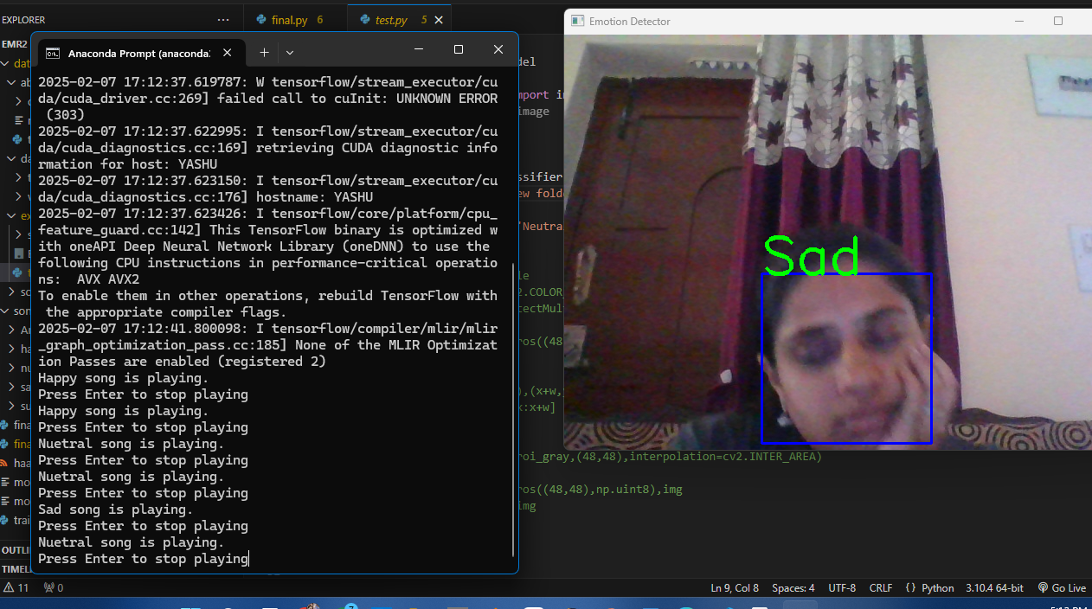
Result

Slide 19
Conclusion
The Emotion Based Music System will be of great advantage to users looking for music based on their mood and emotional behavior. It will help reduce the searching time for music thereby reducing the unnecessary computational time and thereby increasing the overall accuracy and efficiency of the system. The system will not only reduce physical stress but will also act as a boon for the music therapy systems and may also assist the music therapist to therapize a patient

Slide 20
Questions

Slide 21
Thank you!

